Slide 1


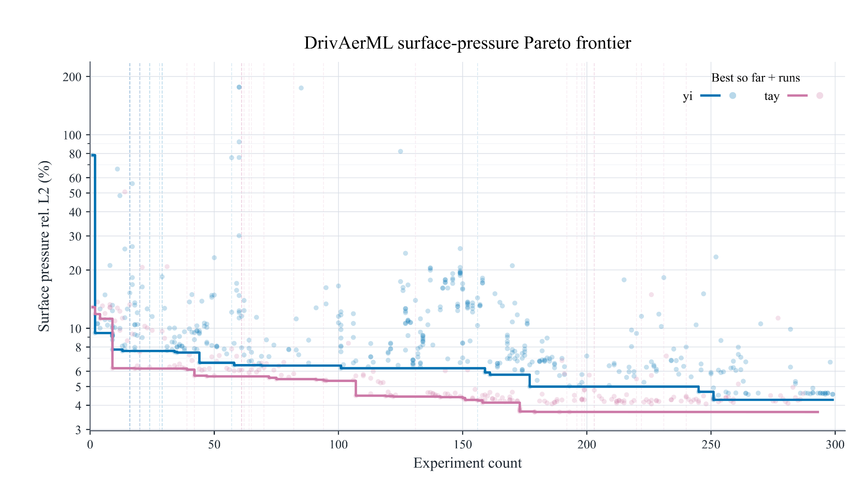
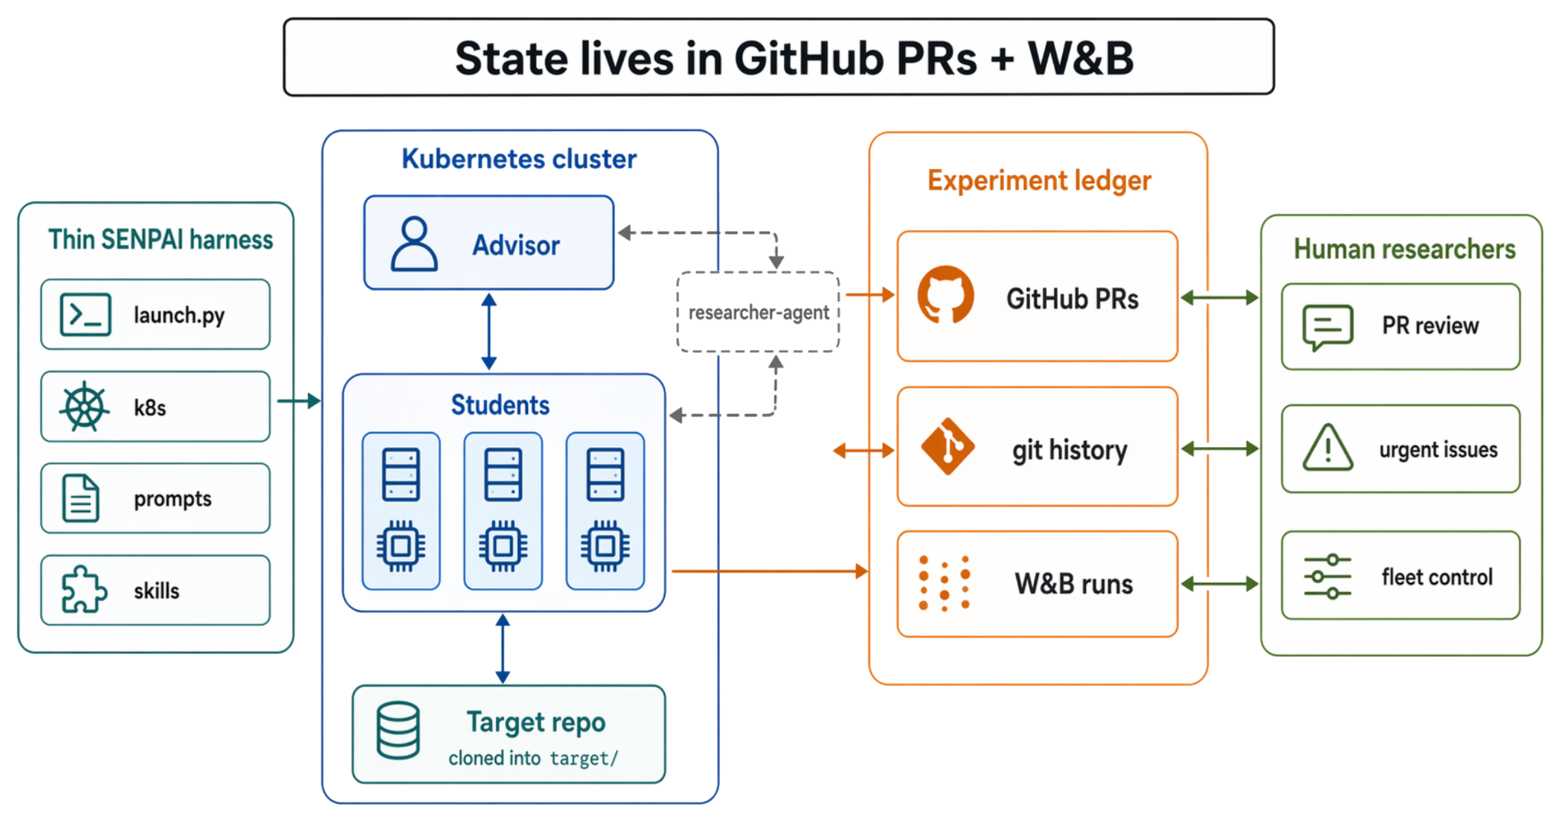
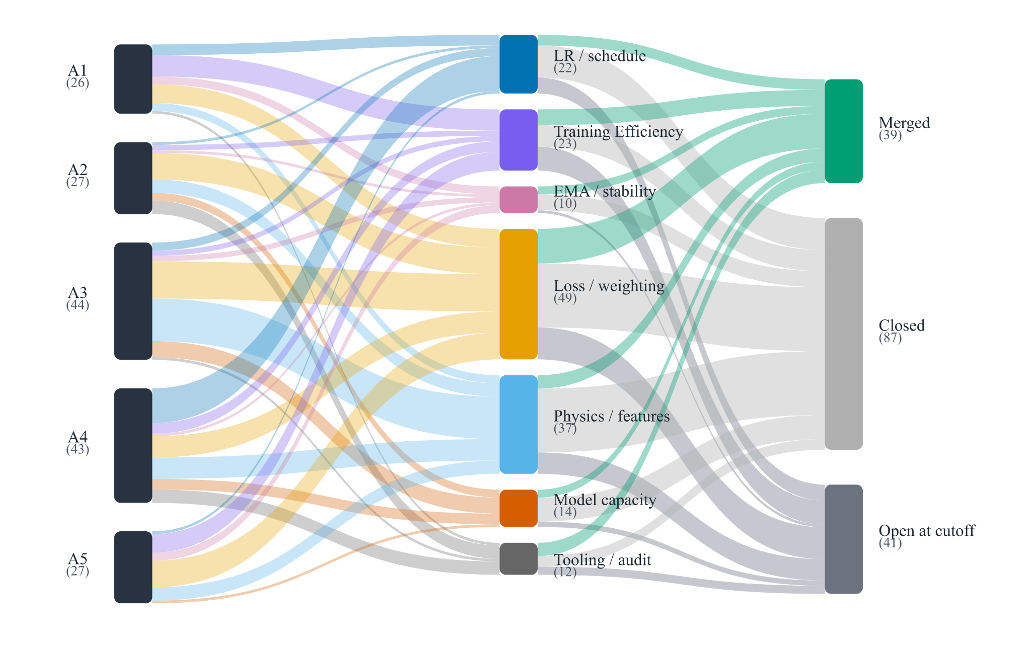

SENPAI
Experiment Ledger As Autoresearch Memory
Thomas Capelle*, Morgan McGuire*, Justin Hodges
Developing domain-specific recipes
Experiment Ledger: Github and an Experiment Tracker
The SENPAI autoresearch loop grounds experiment state in PRs, commits, and experiment-tracker runs, producing a ledger that is queryable by agents and inspectable by researchers. Unlike other autoresearch implementations, this ledger provides easily accessible insight into the research the system is pursuing at any one time as well as the ability to steer the research direction.
DrivAerML
Starting from a Transolver model, SENPAI improves on the original Transolver’s DrivAerML results, discovering a training recipe using STRING positional embeddings from the vision and robotics literature, an insight that CFD researchers alone would be less likely to ever discover.
AirfRANS
Starting from a Transolver model, SENPAI improves substantially on the original Transolver surface-MSE result. The final AirfRANS recipe SENPAI created modified Transolver with fixed multiscale Fourier coordinate features, a surface refinement head, Lookahead-wrapped AdamW, cosine scheduling, EMA with target decay 0.999, and a volume-weighted normalized-MSE objective
 | ps | u | τ | pv
SENPAI (ours) | 3.66 | 5.09 | 6.68 | 3.40
Transolver-3 (Zhou et al., 2026) | 3.71 | 4.14 | 5.85 | 5.72
Transolver (Wu et al., 2024) | 4.81 | 6.78 | 8.95 | 7.74
Training a CFD surrogate on the DrivAerML dataset: The chart shows 2 SENPAI campaigns - the blue, yi, had a per-experiment limit of 30 minutes and 1 GPU. Tay, in pink, was given a 6 hour limit and 8 GPUs. Vertical lines show human interventions such as restarts or guidance.
Agents
Advisor - Student
An orchestrator (Advisor)-worker (Student) approach is taken where the Advisor agent is responsible for setting the research direction via assigning pull requests on github and the Student(s) are responsible for becoming subject matter experts in their assigned task before then executing on the experiment. The Advisor reviews PRs when they are ready and can either request for follow ups, close the PR or merge the result, for example a new model architecture change, into its own branch. Future Students will then start from this updated branch. The Advisor can be steered via opening Github issues.
Skills and sub-agent
SENPAI is deliberately thin with the Advisor and Students responsible for most of the research loop. However both of these agents do have access to a one specialised sub-agent to conduct literature searches. This literature research agent skill is prompted with a taste rubric and uses web search across popular sources as well as Exa’s research paper search mode.
TandemFoilSet-Balanced
We also release TandemFoilSet-Balanced, rebalanced train/val/test splits of the TandemFoilSet (Lim et al.) dataset. We focus on testing interpolation to unseen camber settings and broad Reynolds number generalization. We hope can serve as a useful benchmark for future 2D CFD work.
 | SENPAI (ours) | Transolver | Spider | GeoANF
Surface MSE | 0.00130 | 0.0142 | 0.0043 | 0.0089
Volume MSE | 0.00451 | 0.0037 | 0.0017 | 0.0062
Long-Running Failure Modes
Observed failures: Scientific reasoning is not the bottleneck
SENPAI’s most common failures were harness-engineering failures: monitoring long-running jobs, recovering across compaction or restarts, enforcing brittle tool interfaces, and reconciling PR state with experiment-tracker state. They were less often failures of scientific reasoning. This distinction matters because it suggests that improving autonomous research systems requires better observable infrastructure, not only stronger prompts or more capable models.
Monitor Bloat: Naive experiment monitoring is expensive for agents
Without deliberate harness engineering, monitoring long running experiments can become quite expensive via sending small monitor updates directly into the main agent context. In a 24-hour autoresearch window with 57 Students running, 615 monitors produced 28,246 agent responses, consuming 3.25B (cache-inclusive) tokens. The median agent response reloaded ~110k cached tokens each time while adding only 347 new uncached input tokens.
→ Training monitors should be cheap and escalation-based, surfacing only relevant events such as errors, experiment completion, or metric milestones to the main agent context.
Compaction Drift: SENPAI’s ledger keeps the agent on track after compactions
In a 24-hour window with 240 automatic compaction events across 57 Students, 4.2 per student, contexts reduced from ~196k tokens to 3k token summaries. These summaries were lossy: experiment state drift in the form of mistakes using incorrect GitHub labels or confusion over live experiment state appeared immediately after compaction.
→ SENPAI’s experiment ledger mitigated this drift by externalizing much of the key experiment state. Despite multiple compactions and initial drift, Students were able to use the experiment ledger’s external state to course-correct and take experiments to completion.
Distribution of experiment categories across 5 independent SENPAI campaigns training a CFD surrogate on TandemFoilset-Balanced. Some experiments were open at cutoff due to an enforced 12 hour trial timeout.
Beyond CFD
Domain specific ASR fine-tuning - Formula 1 driver radios
On a well-tuned ASR fine-tuning task SENPAI reduced Word Error Rate (WER) from 18.4% to 15.9% on this noisey, high-jargon private dataset.
Gemma 4 LLM Inference Optimization
When given a task to optimize throughput tokens per second (TPS) on Gemma 4 E4B it on A10G GPUs SENPAI doubled inference from 116 TPS to 268 TPS while incurring less than a 5% drop in quality metrics.

